Slide 1


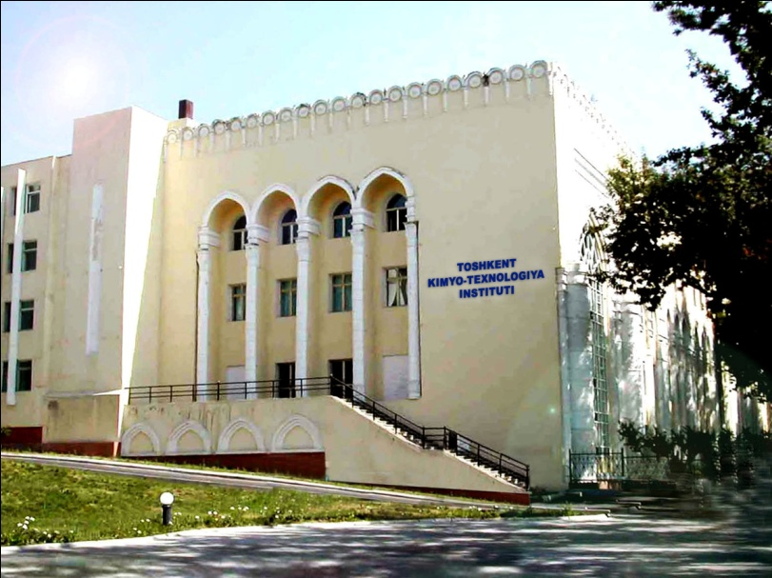
JOINT POSTGRADUATE RESEARCH
PROGRAMME BETWEEN
Tashkent Chemical-Technological Institute and Qaraqalpak State University and Institute of Inorganic and General Chemistry of Academy of Sciences of Uzbekistan
Specialty: 02.00.13 – Technology of inorganic substance
and matreials on their basis
Zebo Babakhanova
Head of the International Relation Department
Tashkent Chemical-Technological Institute
e-mail: zebo.babakhanova@gmail.com
Notes:
Z.Babakhanova. Doctoral education in TCTI (Chemistry)

Slide 2
Doctorate Programs at
Tashkent Chemical-Technological Institute (http://tkti.uz/uz/pages/index/4139)
64 PhD students
14PhD programs
02.00.05-Chemistry and technology of cellulose and cellulose-paper production
02.00.06 – High molecular Compounds
02.00.08 – Chemistry and Technology of oil and gas
02.00.09 – Clarification and certification of goods on the basis of their chemical compositions
02.00.13 – Technology of inorganic substance and matreials on their basis
02.00.14- Technology of organic substance and matreials on their basis
02.00.15 – Technology of silicate and refractory non-metal materials
02.00.16 – Processes and apparatus of chemical technologies and food productions
02.00.17- Technology and biotechnology of processing, strorage and reprocessing of agricultural and food products

Slide 3
Joint programme - an arrangement between two or three Institutions (HEI and Science-research Institute) for shared responsibility of a programme provided for one or more postgraduate research students where a single diploma is issued by at least two higher education Institutions offering an integrated programme and recognised officially in Uzbekistan.

Slide 4
Documents prepared:
1. Agreement - arrangement for sharing responsibility signed by the Presidents of the partner Institutions, each student entering the programme, and each supervisor of a student on the programme. See Appendix 1 for a model MOA.
2. Minimum Requirements to the establishment of an TCTI Joint postgraduate research programme (Appendix 2)

Slide 5
APPROVAL PROCESS
Initial consideration will be given to the proposal by the Department of training highly qualified scientific and scientific-pedagogical personnel of the Research Committee. The Department will require certain assurances about the arrangement from the Partner Institutions (Qaraqalpak State University and Institute of General and Inorganic Chemistry of Academy of Sciences of Uzbekistan) outlining their support for the academic, strategic and business rationale.
The approval process is summarised in the attached flowchart (Appendix 3).

Slide 6
The following appendixes contain main documents of Joint Postgraduate Research Programme:
Appendix 1 Minimum Requirements
Appendix 2 Model of Agreement (MOA)
Appendix 3 Flow Chart – Approval Process
Appendix 4 Approval of Partner Institutions – Issues to be addressed
Appendix 5 Forms applicable to Joint research programmes

Slide 7
MINIMUM REQUIREMENTS
1. Language (English, Russian) and Admission Requirements | The student should meet the currently applicable normal English Language entry requirements. Admission criteria should be based on those of the lead Institution and the admission process approved by both/all Institutions (Decree №304, 22.05.2017): For Basic and Independent PhD students: holders of Magister degree or Specialist Diploma; scientific achievements (at least 1 scientific article and 2 conference abstracts); 2 years of work experience in science and education for Independent PhD students (or patents). For Doctorate and Independent Doctorate candidates: holders of Candidate of Science Degree, PhD or other equivalent degrees, obtained in foreign countries; scientific achievements (3 scientific articles and 2 conference abstracts) Language (English, Russian) for all level of doctoral education: English – B2 or 5.0 (IELTS) Russian – B2 (can read, write and speak)

Slide 8
MINIMUM REQUIREMENTS
2. Length of degree | 3 or 4 years
3. Attendance at Tashkent Chemical-Technological Institute | The minimum attendance requirement is one year in either Institution, but each proposal will be considered on a case by case basis. Where there are more than two Institutions involved the minimum requirement is one year in two of the Institutions.
3. Compatibility of postgraduate research programmes and accreditation mechanisms | At TCTI Joint postgraduate research programmes are subject to rules provided by the current regulation applicable to these programmes. Mechanisms pertaining to accreditation for external modules/learning should be agreed by partner universities in the MOA.
4. Decision on Lead Institution | A lead Institution should be identified. Where Tashkent Chemical-Technological Institute assumes this role, the rules and regulations of TCTI will apply. Similarly, where the partner Institution is the lead Institution, its rules and regulations will apply notwithstanding the right of TCTI to approve the examination procedures. Students will be registered students of TCTI for all years of their Joint programme and will be registered students of the partner Institution/s as agreed in the MOA. Students will be entitled to use the support services of all Institutions involved.

Slide 9
MINIMUM REQUIREMENTS
5. Supervision | In addition to supervisory requirements applicable to regular TCTI research programme, one supervisor from each partner Institution is required. The level of supervision required from TCTI should be considered in the context of the supervisor experience and resources available at the partner Institution(s). As a minimum, the following meetings should take place in each academic year: Two face-to-face meeting between the two Supervisors and the student. Four face-to-face or virtual meeting between the Supervisors. Monthly meetings between a supervisor and the student. All parties should maintain regular e-mail contact.
6. Thesis | The thesis will normally be written and defended in Russian (or English) and it should include a summary written in English, Uzbek, Qaraqalpak and the language of the partner Institution/s unless stated otherwise in the MOA. The University’s current regulations for thesis format should be followed. The number of copies of the thesis will be specified in the MOA. In addition to the above, an electronic version of the thesis should be submitted to TCTI.
7. Examination Process | The Examiners shall include a minimum of one examiner from each Institution, who shall not be a Supervisor. Where established practices in the partner University require the presence of the Supervisor at the Viva, such practices will be respected. The Examiners shall include, as a minimum, one external examiner appointed by TCTI. The partner Institution/s may also appoint an external examiner where appropriate. If PhD thesis is defended at partner university, a copy of the agreed final report will be required and a "Declaration of Recommendation of Examiners of a Joint PhD Viva Voce Examination" will have to be submitted by the partner university to Department of training highly qualified scientific and scientific-pedagogical personnel of TCTI .

Slide 10
DRAFT
AGREEMENT
between
Tashkent Chemical-Technological Institute
and
Qaraqalpak State University
(or Institute of Inorganic and General Chemistry of Academy of Sciences of Uzbekistan)
and
(Research Student)
Jointly Awarded PhD (DSc) Degree
Specialty: 02.00.13 – Technology of inorganic substance
and materials on their basis

Slide 11
Art. 1.3
The thesis shall be researched and written in at least two alternating periods at the Institutions.
The duration of such periods shall be fixed by Agreement between the two Thesis supervisors.
The Student will spend at least 6 months in either institution.

Slide 12
Art. 1.4
PhD students shall be registered in all partnering Institutions.
Scholarship provided by the Government of Uzbekistan for all PhD students will be transferred to partner institutions as follows:
Year 1 - Scholarship fees payable to TCTI (Lead Institution);
Year 2 - Scholarship fees payable to one of partner institute (QarSU or IGIC AS Ruz);
Year 3 - Scholarship fees payable to one of partner institute (TCTI, QarSU or IGIC AS Ruz).

Slide 13
Second Part - Admission Criteria and Process
Art. 2.1
Admission Criteria (subject related):
For Basic and Independent PhD students:
holders of Magister degree or Specialist Diploma;
scientific achievements (at least 1 scientific article and 2 conference abstracts);
2 years of work experience in science and education for Independent PhD students (or patents).
For Doctorate and Independent Doctorate candidates:
holders of Candidate of Science Degree, PhD or other equivalent degrees, obtained in foreign countries;
scientific achievements (3 scientific articles and 2 conference abstracts)

Slide 14
All support for the cost of travel to and from institutions will have to be provided by the student or scholarship scheme, as appropriate.
The difference between a joint PhD and joint supervision is that a student is registered in both institutions for the duration of the PhD and receives a joint award from the two Institutions.
Current regulations allow for an external supervisor to act as co-supervisor for a students registered at TCTI. The award of the PhD in this case is made solely through TCTI and the Institution where the external supervisor is based does not receive any compensation. Joint supervision is also practised where the partner institution does not have degree awarding powers.
Students will be registered students of TCTI for all years of their Joint programme and will be registered students of the partner Institution/s.
Students will be entitled to use the support services of all partner Institution/s.

Slide 15
Art. 3.2
Description of the PhD programme.
There are three main educational elements to the Ph.D. programme, namely:
Research Work,
Education Courses in Chemistry and Chemical Technology,
Professional Training, as detailed below.

Slide 16
Education Courses (Modules) in Chemistry and Chemical Technology
A range of education courses is provided, varying from taught courses to masterclasses; these may vary from year to year. These courses are provided within the Department and in cooperation with other Centres and Departments in Uzbekistan. The type and number of courses PhD student will take depending personal needs and research topic. Selection of courses should be discussed with Supervisor.
Educational elements of PhD Programme on Specialty 02.00.13 – Technology of inorganic substance and matreials on their basis:
General Chemistry,
General Chemical Technology,
Chemistry of high-molecular compounds,
Methods of physical-chemical analysis,
Inorganic chemistry,
Thermodynamics,
Applied Mathematics,
Transport,
Kinetics.

Slide 17
Professional Training Modules:
Training in communication and writing skills will be provided through Faculty of Professional Education of TCTI and the relevant departments in partner institutions (details will be provided under Generic Skills on the Department of training highly qualified scientific and scientific-pedagogical personnel of TCTI).
Training in the commercialisation of research and intellectual properties issues will be provided by Department of Commercialization of scientific innovation developments of TCTI (or other relevant Departments in partner institutions).
The Center for retraining and advanced training of pedagogical personnel at TCTI and Department of quality control of TCTI offers a course for tutors and demonstrators (TCTI Professional Certificate in Teaching and Learning in Higher Education).
In addition, student will receive training in generic skills on a one-to-one basis with supervisor by giving presentations on research work, group meetings and report writing. Information on these courses will be given to all students at the beginning of the academic year.
Other Generic and 7 Transferable Skills modules are available; a full list will be available on the Department of training highly qualified scientific and scientific-pedagogical personnel webpages. Some of Generic and 7 Transferable Skills modules listed above:
Employability Skills, writing a CV or Resume
Research and Analytical Skills
Commercialisation of research and intellectual properties
Verbal Communication and presentation skills
Written communication, science article writing and scientific journals
Personal Motivation, Organisation and Time Management
Communication Skills
Numeracy Skills
IT Skills
Learning How to Learn
Problem-solving Skills
Working with Others
Subject-specific Competencies

Slide 18
Initial Meeting Report
Student Name
Student No.
Registered Programme (PhD or DSc)
Full-time/Part-time
Supervisor Name
Co-Supervisor (if applicable)
Supervisory Team (if applicable)
External Supervisor(s) (if applicable)
Date of Meeting
Provisional Title of Project
Briefly list up to 5 key objectives for the project in the first year
Induction
Did you attend the University Induction Programme? | Yes No
Have you read the regulations and schedules of the University for higher degrees by research, in particular the Framework for Delivery of Structured Doctoral Programme? | Yes No
Have you read the administrative structures and processes of the University relevant to research applications as outlined in the Route of Academic/Administrative Progression to the Research Masters/PhD Degree from application to Thesis Submission? | Yes No
Have you read the PhD Supervisory Policy? | Yes No
Have you read the University Safety Policy, the Ethical Review and Research Integrity Policy, the Inventions and Patents Policy and the Freedom of Information Policy? | Yes No
Did you receive a copy of the Departmental Graduate Handbook? | Yes No
If applicable, did you attend the Departmental Induction Programme? | Yes No

Slide 19
END OF YEAR 1 OF RESEARCH
Review Form A
Review should take place during December at the final of Year 1 of research:
Part a: To be completed by the student prior to the Year 1 Progress Meeting
Research Indicators:
Conferences and Courses:
Student Name/Student No.
Supervisor Name
Date of Meeting
Conferences and Meetings Attended | Name of Conference, and Dates Attended
Visits to Other Laboratories | Name of Laboratory, Purpose of Visit, Duration of Visit
Technical Training Courses | Name of Course and Dates Attended
Taught Research Modules Passed | Name of Module, University Attended, No. of Hours.
Generic Skills Modules Passed | Name of Module, University Attended, No. of Hours
Masterclasses Taken | Name of Masterclass, University Attended, No. of Hours

Slide 20
Problems and issues of JDP in Uzbekistan
Financial questions? Financing of joint reseach, lab equipment, salary to 2-3 PhD advisors, travels and leaving expenses.
Organization of Courses? Open Courses? Financial issues.
Intellectual property issues.
Management system? Different departments and institutes are involved in JDP.
Quality control procedures. All partners are committed to ensuring that each cohort of registered students will be able to complete programmes satisfactorily.
How will look like JDP diploma?

Slide 21
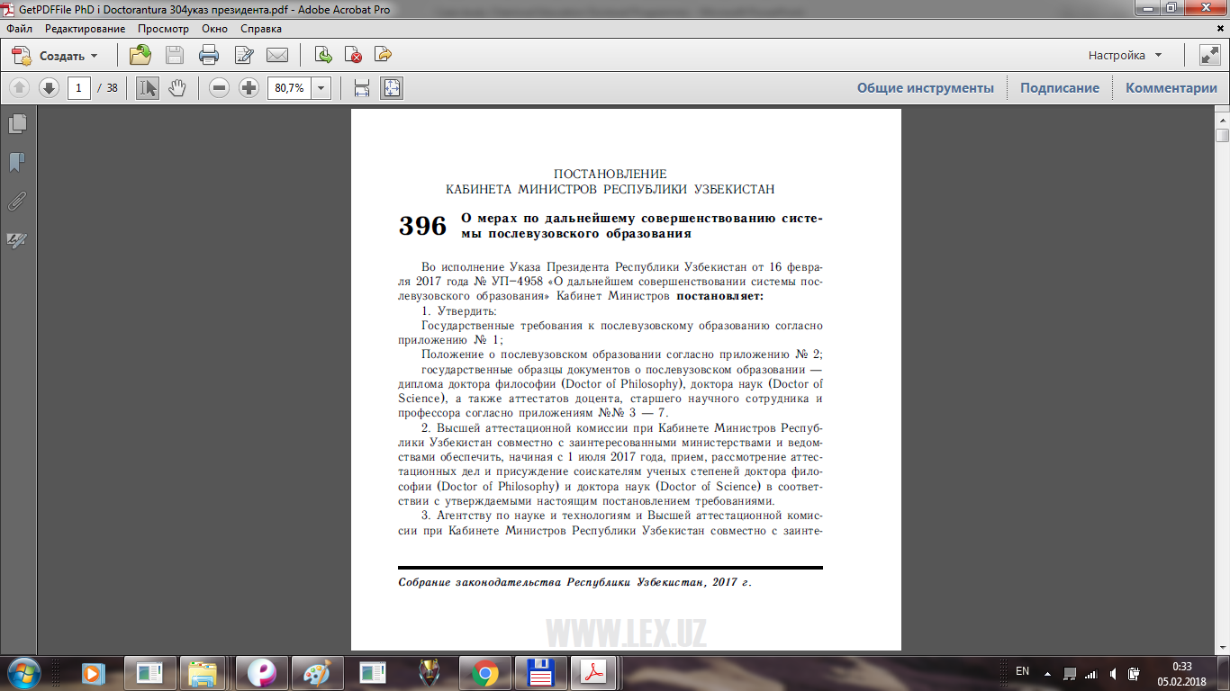
Main regulatory documents in Doctoral Education (www.lex.uz):
Resolution of the President of the Republic of Uzbekistan PR-4958 on 16 February 2017 “Further improvement of post-graduate education system”
Decree #396 of Council of Ministers of Uzbekistan on 22 of May 2017 “On measures for further improvement of post-graduate education system” establish the rules for admission and training in doctoral studies, evaluation and requirements for dissertations, procedure of the defense of dissertations (thesis)

Slide 22
Decree “On measures for further improvement of post-graduate education system” (22/05/2017 )
Types of post-graduate education
Basic doctorate
Doctorate
Duration
Maximum - 3 year
Maternity leave – up to 3 years
Admission rules
Entrance exams (Specialty, English) for Basic doctorate students
Interview for Doctorate students and Independent doctorate candidates
Independent doctorate
Academic leave for sickness or military training

Slide 23
Decree “On measures for further improvement of post-graduate education system” (22/05/2017 )
Scholarship
Provided by Government for all local doctorate candidates
Tuition fee
All international doctorate candidates
Admission rules
For Basic and Independent doctorate students: holders of Magister degree or Specialist Diploma; scientific achievements (at least 1 scientific article and 2 conference abstracts)
For Doctorate and Independent doctorate candidates: holders of Candidate of Science Degree or PhD; scientific achievements (3 scientific article and 2 conference abstracts)
Admission rules
The Doctoral Candidate's basic specialty must correspond to the direction of doctoral studies

Slide 24
PhD Education programme
I
Scientific Supervisor
II
Individual plan for 3 year
III
Course of specialty discipline (exam)
IV
Course of English language (exam)
V
Wide discussion of research results at conferences, implementation of scientific results in industry - recomended
VI
At least 3 scientific articles (1 of them in International Journal)
VII
Pedagogic activity (100 hours)
VIII
Independent study of the subject “Methodology of the experiment” and 3 Cources close to the specialty
IX
PhD Thesis: 120 pages, more than 120 references
IX
Synopsis of Thesis in Uzbek, Russian and English

Slide 25
Doctoral Education programme
I
Scientific Advisor (or without it)
II
Individual plan for 3 year
III
Course of specialty discipline
IV
Course of English language
V
Wide discussion of research results at conferences, implementation of scientific results in industry - compulsory
VI
At least 10 scientific articles (1 of them in International Journal)
VII
Pedagogic activity (100 hours)
VIII
Independent study of the subject “Methodology of the experiment” and 3 Cources close to the specialty
IX
Doctoral Thesis: 220 pages, more than 200 references
IX
Synopsis of Thesis in Uzbek, Russian and English

Slide 26
Common problems and recommendations
Problems
Lack of soft skills of candidates (in management, industry implementation, communication with business) Lack of access to paid databases, software, laboratory resources Insufficient knowledge of the foreign language Financial and informational dificulties in Publication of article in International peer reviewed Journals
Recomendations
Financial support for participation in Internation Conferences, International Mobility for doctorate candidates More soft skills courses Organization of meetings of doctorate candidates with business and industry
Degree of success | Would be high: with the appropriate material and technical re-equipment, expansion of communication with enterprises, scientific centers, effective system of motivation of candidtes, with active use of special literature in English Special “soft skills” courses and trainings for doctorate candidates

Slide 27
Particular problems and solutions
Problems | Solutions
No free access to Science Direct, Springer, Fransis and Taylor, Wiley publications | Organization modern Library facility
No access to databases (SciFinder (Chemical Abstract), Beilshtein) | Web of Science subscription
Laboratory (classical sets of experiments + limited modern research equipment) | Organization modern laboratory Center
Special software (MathCad, Math Lab, Accels Materials Studio and others) | Purchase licensed software for University
Started open ware courses | Organization of Video courses
Organization International Fellowship (more than 3 months) | Istedod Foundation (42 000 mln sum)

Slide 28
THANK YOU
FOR YOUR ATTENTION!
Zebo Babakhanova
Head of International Relations Department of TCTI
e-mail: zebo.babakhanova@gmail.com

