Slide 1
JOINT POSTGRADUATE RESEARCH PROGRAMME BETWEEN
Tashkent Institute of Finance (TIF) and Samarkand Institute of Economics and Service (SIES)

Slide 2
Specialty
08.00.08 – Accounting, economic analysis and auditing
08.00.07 – Finance, cash flow and credit

Slide 3
At the end of this program, all doctoral candidates will receive PhD diploma of governmental sample

Slide 4
Basic documents for the implementation of the joint postgraduate program:
MoU of joint work on the implementation of the PhD and Master program This Agreement shall be effective from January, 2020 and is approved for a period of 5 years.

Slide 5
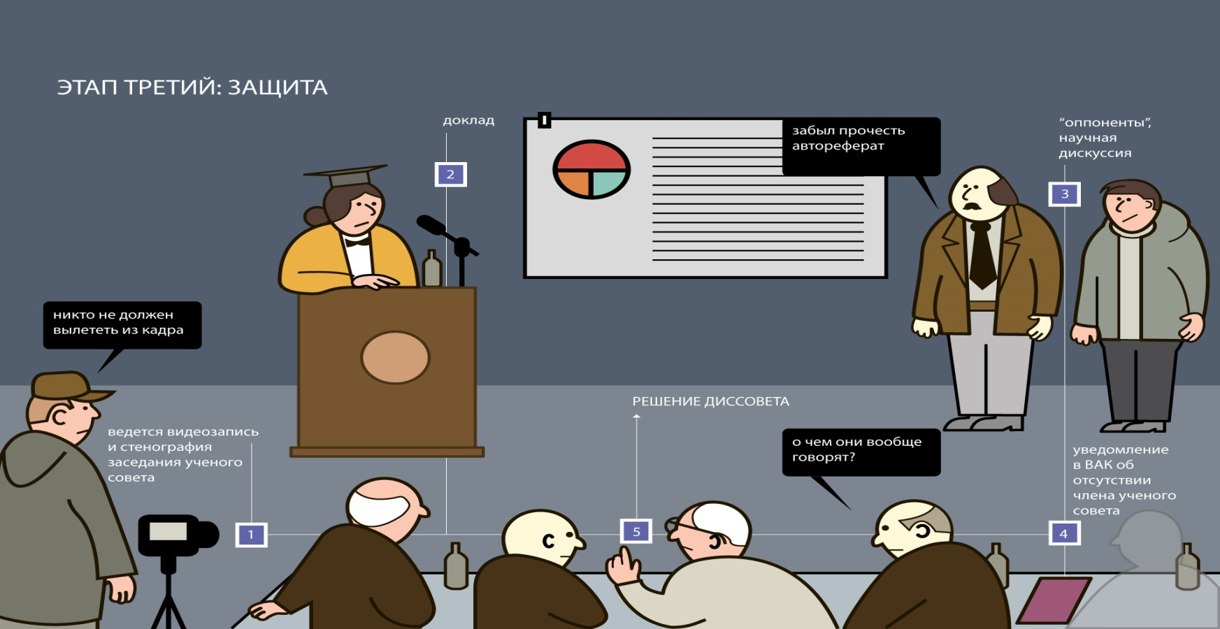
Duration of education
3 years (it is allowed to defend on the 4th year)

Slide 6
Scholarship provided by the Government of Uzbekistan
1-year TFI
2-year SIES
3-year (Scholarship fees payable to one of partner institute TFI or SIES)

Slide 7
Documents of Joint program
Minimum requirements
Flow Chart – Approval Process
Approval of Partner Institutions – Issues to be addressed
Forms applicable to Joint research program
Model of Agreement (MoU)

Slide 8
Admission Criteria
1
Master degree Diploma or Specialist Diploma;
2
at least 1 scientific article and 2 conference abstracts;
3
4
2 years of work experience in science and education ;
English Language Competency: B2 (CEFR), 5.5 (IELTS), 567 (TOEFL PBT);
For DSc –holders of Candidate of Science Degree or PhD (3 scientific articles and 2 conference abstracts)
5

Slide 9
Admission Process
Obtained permission from his/her supervisor and from co-supervisor;
formal application of the candidate;
To pass enroll exam on specialty and on foreign language .

Slide 10
Attendance
The PhD student must spend a minimum of 12 months at the partner Institution;
up to a maximum of 1,5 years over the duration of 3 year programme

Slide 11
Quality Assurance of Education
An individual plan is drawn up for the entire period of study;
PhD students are assigned to have advisors with PhD degree (for DSc students are assigned scientific consultants);
The positive assessment of all supervisors shall be a necessary prerequisite for admission to the final examination.

Slide 12
Description of the PhD programme
Education Courses
Professional Training
Research Work

Slide 13
Programme Research Work
To learn research methodologies and develop problem solving skills;
Scientific seminars and sessions holded by international experts;
Doctoral candidate is required to attend these seminars..

Slide 14
Education Courses
Economic theory;
Accounting and audit;
Finance and Credit;
Methods of quantitative and qualitative analysis of economics;
Econometrics;
Foreign language.

Slide 15
Professional Training
Teaching -total 100 h. in a year;
Participation in the scientific seminars of the departments with reports on the research issues (at least 1 time per year).

Slide 16
Quality control
Implementation control of the individual plan (attestation - at least 1 time per year);
Passing g exams of qualification;
Publications on the topic of the thesis (for PhD 7 scientific papers, including 3 scientific articles and 1 in international journal; for DSc 15 scientific works, including 10 articles, 1 in international journal, 1 monograph);
Two times face-to-face meeting between the all Supervisors and PhD student
(minutes);
Four times face-to-face or virtual meeting between the Supervisors(minutes);
Monthly meetings between a supervisor and the student (according confirmed schedule);
All parties should maintain regular e-mail contact;
Annual report of supervisors.

Slide 17
Progression
1-year:
Approved individual plan on the topic of the thesis for 3 years (in the context of each year);
Approved theoretical and methodological program for the specialty and its implementation;
Publishing articles in journals;
Presentation at the seminar to discuss results of PhD thesis;
Passing the qualification exams on foreign language;

Slide 18
2-year:
Publication of the articles in journals like (Biznes ekspert, Moliya, Ekonomicheskoe obozrenie, Ekonomicheskiy vestnik,Uzbekistan and etc.) and in international journals;
Making a Report at a scientific seminar on the results of the PhD Thesis;
Passing qualifying exam according to the specialty.

Slide 19
3-year:
Passing of teaching activity in the specialty (100 hours);
Implementation of the obtained scientific results in the educational process;
Presentation in a scientific conference or symposium on the topic of PhD thesis.

Slide 20
The defense of the doctoral thesis will be carried out at the joint council for the defense of doctoral theses, consisting of scientists from two universities and other organizations.

Slide 21
Requirements for the doctoral thesis
The thesis shall be written and orally defended in Russian (Uzbek, or English) languages;
Abstract of PhD thesis should be printed in 100 copies and submitted in all HEI and scientific institutions in Uzbekistan, disseminated throw internet to foreign leading Universities in the same field of study and uploaded on the website of all partner institutions;
It is necessary to provided PhD (Dsc) documents: hard bound copies and 5 copies of CDs: 2 copies – for the Lead Institution, 1 copy – for each participating partner institution. One hard copy will be deposited to the TFI Library and the electronic version of the thesis will be made available in TFI open access repository.

Slide 22
Recommendations for creating a virtual doctoral center
Created Doctoral Centers in each institutions
All these Centers join in unified Virtual Doctoral Centre
VDC works on the basis of the provision developed and approved at the Council of universities

Slide 23
The aim of the virtual center: improving the quality of doctoral education on the base of the organization of interaction between these centers.
KSU
TKTI
KarSU
TFI
NamSU
UzSIAC
SIES

Slide 24
Organization of admission to the joint doctoral program
Organization of entrance exams

Slide 25
Discussion of the research program
Discussion of the theoretical and methodological research program
Consultations supervisors of doctoral students according schedule

Slide 26
Discussion of the results of the research on scientific seminars
Conducting of the online conferences with the practice holders
Discussion of the each research results of the candidates with supervisors

Slide 27
Trainings on writing and publishing scientific articles
Trainings on writing articles in the journals of international databases (Scopus, Web of Science)

Slide 28
Course of lectures on economic and mathematical modeling of economic phenomena (Lecturer from Czech Republic:
Sh .Tashpulatov)
Courses on foreign languages and specialties

Slide 29
Using online technologies for reviewing and opposing the results of dissertation research
Seminars in leading organizations through the network and other scientific seminars

Slide 30
Defense of the thesis in a public

Slide 31
Thank you for attention!

